Slide 1
Programming

Slide 2

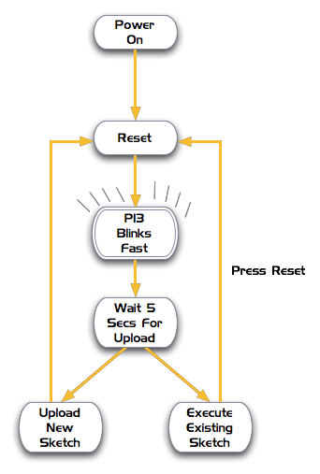
Programming an Arduino
Write program
Compile (check for errors)
Reset board
Upload to board

Slide 3
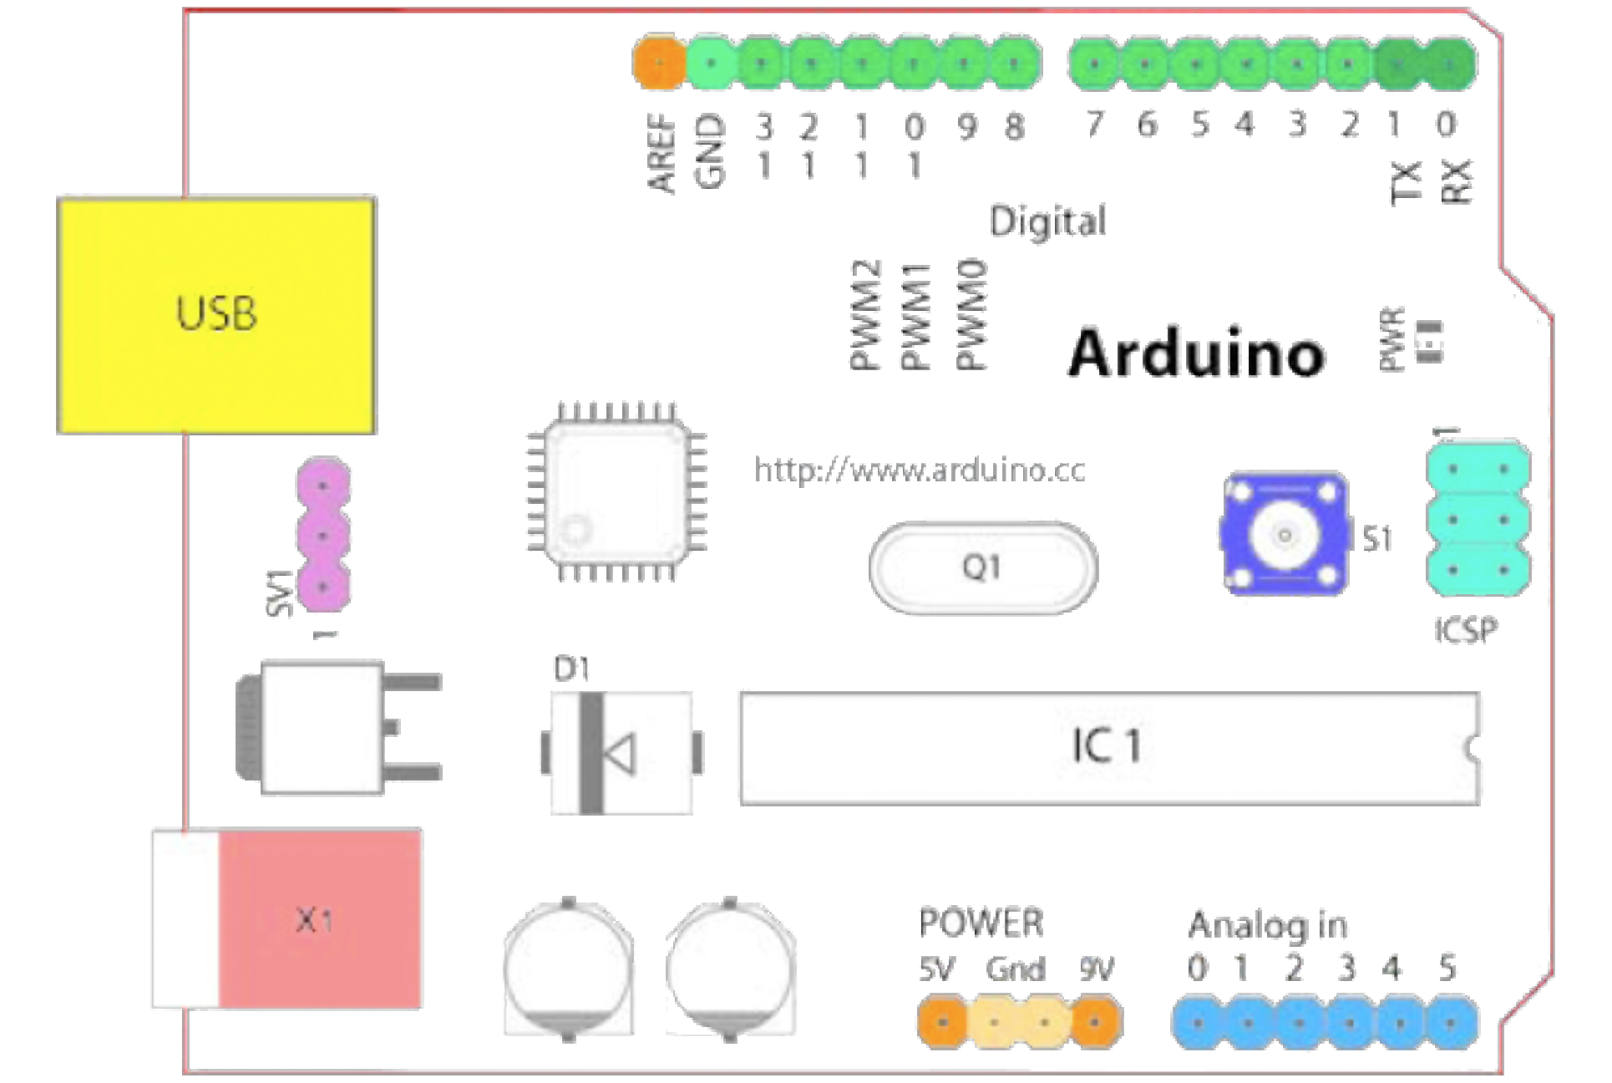
Input and Output ports
14 Digital IO (pins 0 - 13)
6 Analog In (pins 0 - 5)
6 Analog Out (pins 3, 5, 6, 9, 10, 11)

Slide 4
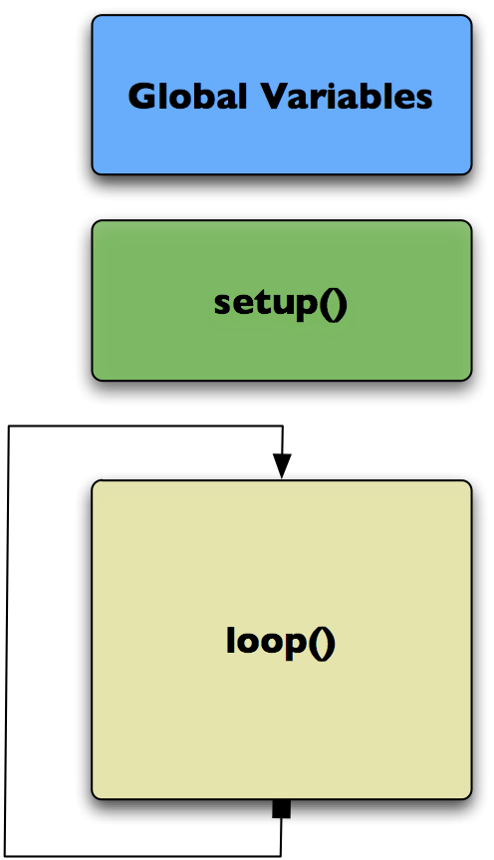
An Arduino “Sketch”
Declare variables at top
Initialise
setup() – run once at beginning.
set pins
Running
Loop() – run repeatedly, after setup()

Slide 5
Global Variable
Global Variables
Int ledPin = 13;
//led connected to control pin 13
Int aSensor = 0;
//setup sensor ‘aSensor’ on analog pin 0
Int statePin = LOW;
//use this to hold the state of a pin

Slide 6
Setup module
pinMode()
– set a pin as input or output
serial.Begin()
– setup to `talk‘ to the computer
Setup()

Slide 7
Setup module example
pinMode(ledPin, Output);
– set a pin as input or output
serial.Begin(9600);
– setup to `talk‘ to the computer
Setup()

Slide 8

Loop module
digitalWrite() – set a digital pin high/low
digitalRead() – read a digital pin’s state
analogRead() – read an analog pin
analogWrite() – write an “analog” PWM value
delay() – wait an amount of time
millis() – get the current time
loop()

Slide 9
Digital? Analog?
Digital – only has two values: on/off
Analog – has many (infinite) values
Computers don’t really do analog – use quantisation instead

Slide 10
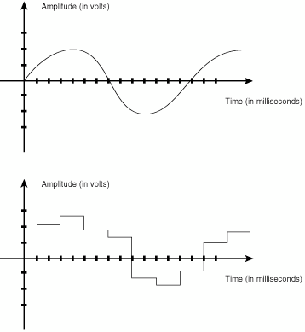
Digital? Analog?
Many states (Analog) or just two (HIGH/LOW - Digital)
Number of states (or “bins” is resolution)
Common computer resolutions:
8-bit = 256 states
16-bit = 65,536 states
32-bit = 4,294,967,296 states

Slide 11
Experimentation

Slide 12
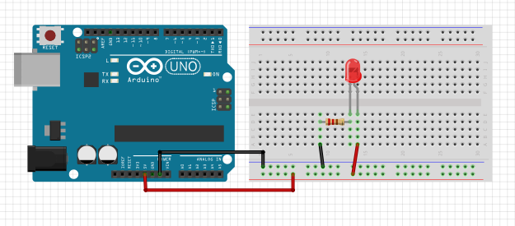
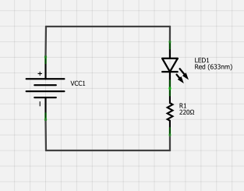
Simple Layout
Connect the power bus first.
Add the LED and resistor.
Connect them to the power bus.

Slide 13
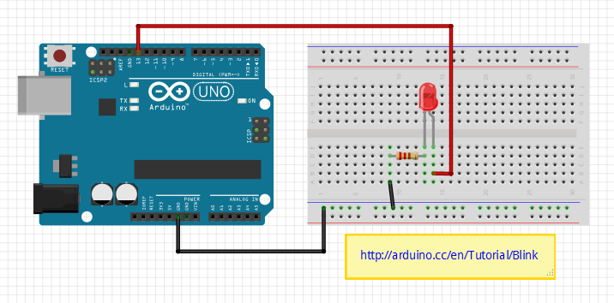
Blinky LED Layout
Move the red wire from 5V to pin 13.

Slide 14
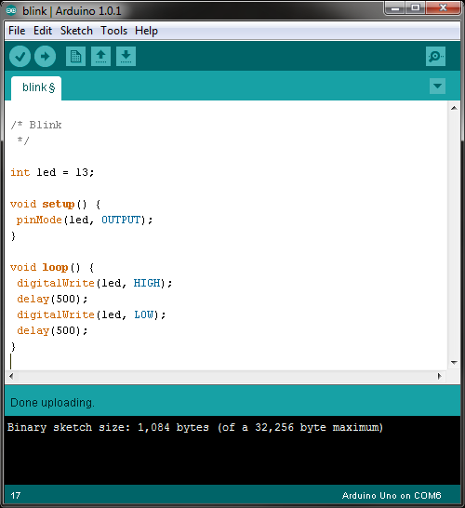
Blinky LED Code
What happens if you move the red wire to 5V and the black to pin 13.

Slide 15
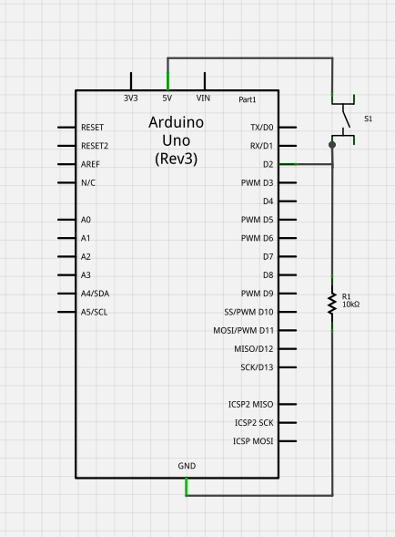
Button Schematic
We’ll light up the internal LED when the switch is pushed.

Slide 16
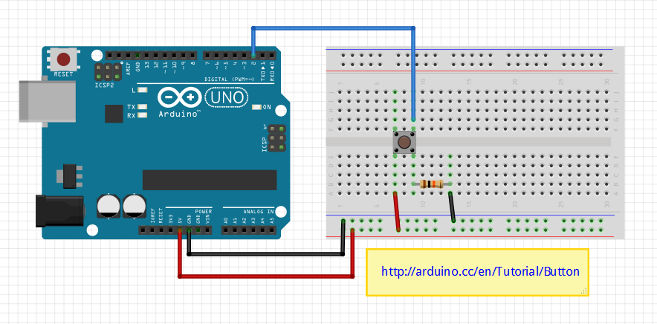
Button Layout
Why the 10K resistor?

Slide 17
Button Code
/* Button */
const int buttonPin = 2; // the number of the pushbutton pin
const int ledPin = 13; // the number of the LED pin
int buttonState = 0; // variable for reading the pushbutton status
void setup() {
pinMode(ledPin, OUTPUT);
pinMode(buttonPin, INPUT);
}
void loop() {
buttonState = digitalRead(buttonPin); // read the state of the pushbutton value
if (buttonState == HIGH) {
digitalWrite(ledPin, HIGH);
}
else {
digitalWrite(ledPin, LOW);
}
}
You can make this code a lot shorter!

Slide 18
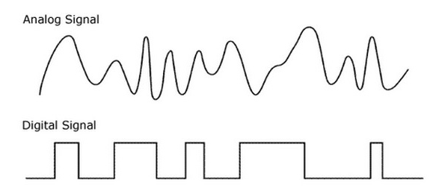
Analog vs. Digital
Analog outputs are expensive!

Slide 19
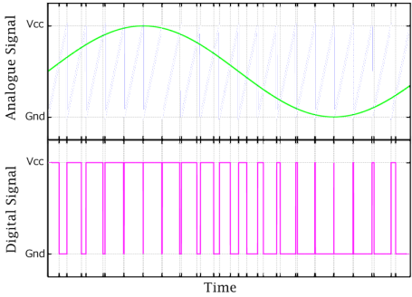
Analog vs. PWM Signals
PWM is cheap to implement!
Notes:
An optional slide, depending on the audience.

Slide 20
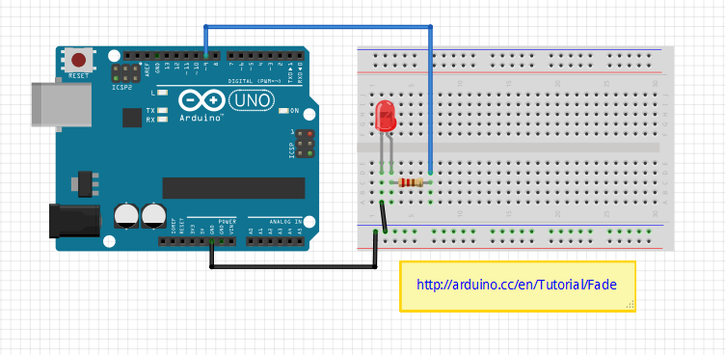
Fade Layout

Slide 21
Fade Code
/* Fade */
int led = 9 // the pin that the LED is attached to
int brightness = 0; // how bright the LED is
int fadeAmount = 5; // how many points to fade the LED by
void setup() {
pinMode(led, OUTPUT); // declare pin 9 to be an output
}
void loop() {
analogWrite(led, brightness); // set the brightness of pin 9 (it’s not really analog)
brightness = brightness + fadeAmount; // change the brightness for next time through the loop
if (brightness == 0 || brightness == 255) { // reverse the direction of the fading at the ends of the fade
fadeAmount = -fadeAmount ;
}
delay(30); // wait for 30 milliseconds to see the dimming effect
}

Slide 22
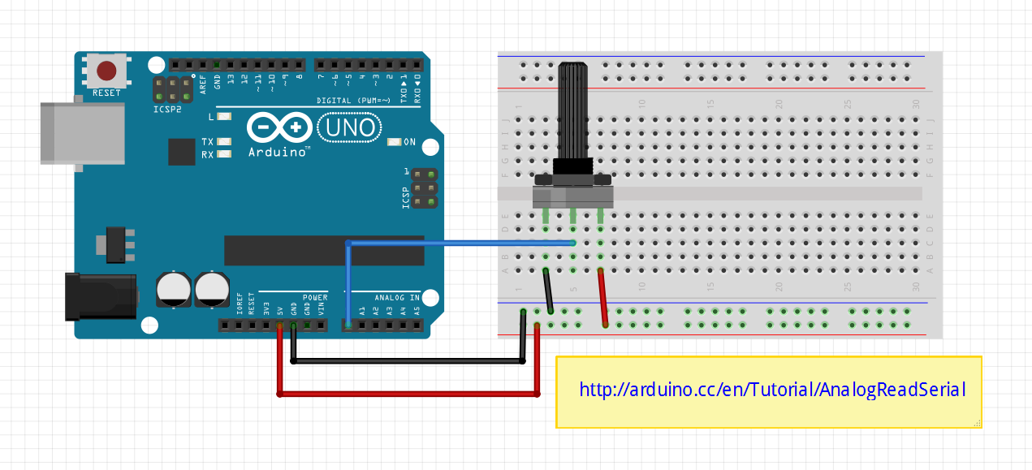
Analog Read Layout

Slide 23
Analog Read Code
/* Analog Read */ void setup() { Serial.begin(9600); // initialize console output at 9600 bits per second } // Press ctrl-shift-m to bring up the console void loop() { int sensorValue = analogRead(A0); // read the input on analog pin 0 Serial.println(sensorValue); // print out the value you read delay(10); // delay in between reads for stability }
The potentiometer is logarithmic
while the joystick is linear.

Slide 24
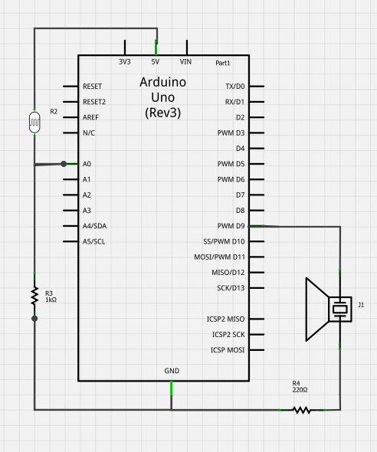
Light and Sound Schematic

Slide 25
Light and Sound Code
/* Light and Sound */
void setup() {
Serial.begin(9600);
}
void loop() {
int sensorReading = analogRead(A0);
Serial.println(sensorReading);
// map the analog input range (in this case, ~80 - 310 from the photo resistor)
// to the output pitch range (100 - 1000Hz)
int thisPitch = map(sensorReading, 80, 310, 100, 1000);
tone(9, thisPitch); // play the pitch on pin 9
delay(1); // delay in between reads for stability
}
Not quite the same value resistors as on the web site – so fudge it!

Slide 26
A simple program
As an example let us consider the interfacing of an LED to the port of MSP430 and blink it by writing a C program. Here we have considered two cases of active low and active high and the LED is connected to Port 2 pins of the MSP controller .The circuits are shown in the next slide.

Slide 27
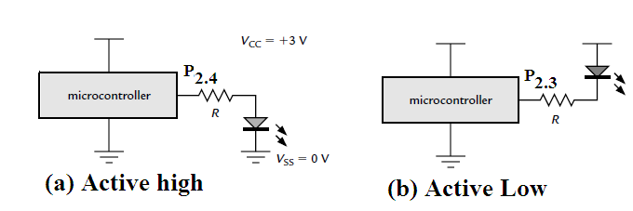
Circuits

Slide 28
Program
#include <msp430x11x1.h> // Specific device
void main (void)
{
WDTCTL = WDTPW | WDTHOLD;
// Stop watchdog timer//
P2DIR = 0x18;
// Set pins with LEDs to output , 0b00011000//
P2OUT = 0x08;
// LED2 (P2.4) on , LED1 (P2.3) off active low!)//
for (;;) { // Loop forever ...
} // ... doing nothing
}

Slide 29
Explanation
The first line of C stops the watchdog timer , which would otherwise reset the chip after about 32 ms.
The two pins of port P2 that drive the LEDs are set to be outputs by writing to P2DIR. For safety the ports are always inputs by default when the chip starts up
The LEDs are illuminated in the desired pattern by writing to P2OUT. A 0 lights an LED and 1 turns if off because they are active low.

Slide 30
Tips for getting started with microcontrollers and electronics
This can be an intimidating field to get into if you don't enter in at the right point.
Recommendation:
Start off with an Arduino experimentation kit from adafruit.com
Learn how to turn lights on and off, and to read from analog devices, and get more complex with the programming
Progress forward in little steps, especially if you are learning c/c++ for the first time
Have a project Idea in mind as a goal
Youtube is full of tutorials and demonstrations of arduino boards
Visit Hackaday and instructables to find some interesting projects
Challenge yourself as much as possible, and if you are up to it, read the chip documentation, even if none of it makes sense
AVRfreaks is a great community for expert level coding of avr controllers
DO NOT be intimidated if you start getting into big issues programming. Every learning coder goes through a phase of absolute frustration when learning for the first time.

Slide 31
Programming Tips
Programming is a skill, not a talent. It is learned through experience and research.
A program will do exactly what you tell it to do, not what you want it to do.
MIT tells its CS students that the most effective debugging tool in the industry is the "print" function
Always read the manual. languages are implemented differently on every platform, and all platforms behave slightly differently from each other
There is no such thing as too much documentation
Most of the work of good coding is in planning and maintenance, not the actual process of writing the code
Code first, optimize later
if a code has multiple complex things, code and test each function separately, and then include them into your main project
As with anything that is ever done in life, Keep It Simple, Stupid.

Slide 32
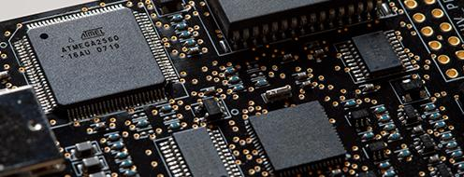

Closing Remarks
There are many microcontrollers out there of various performance levels and difficulties
These devices can be used to compute and automate the operation of almost every electronic device imaginable
Some of these small chips outperform full personal computers from the 80's and 90's
These platforms are useful for their own reasons and have their own limitations

Slide 33
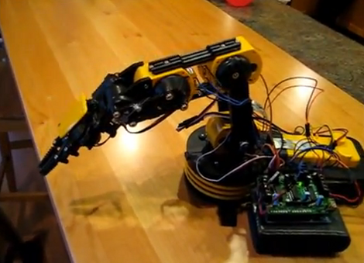
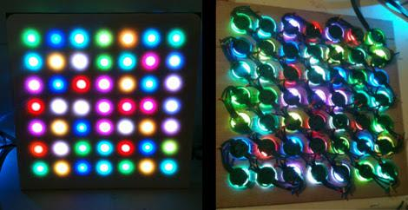
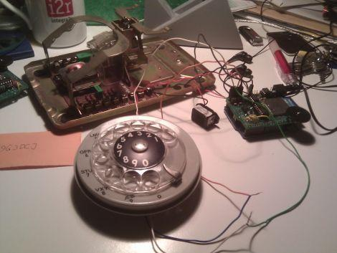
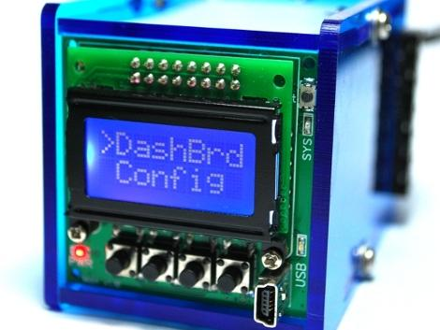

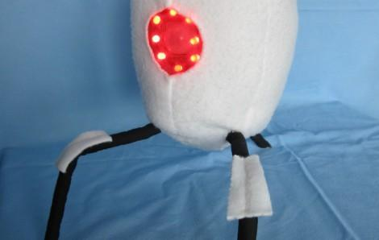
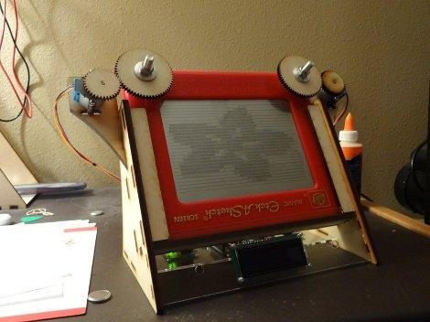
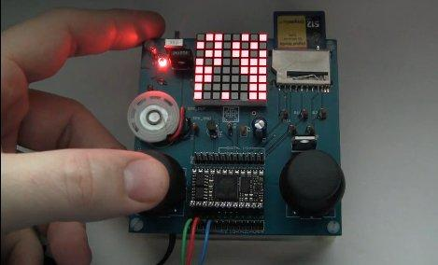
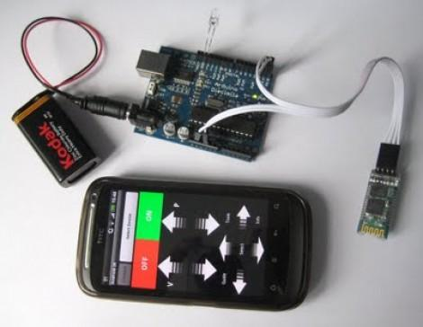
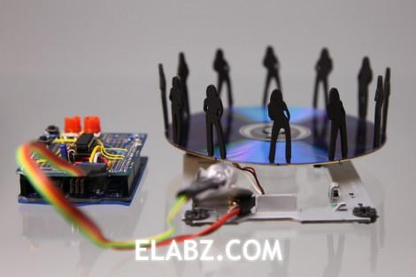
What Will You Make?

